Slide 1
Real Algorithm
Just started

Slide 2
Write code following output below
Case 1
> 2
>​ A
AA
result = ""
number = int(input("Enter here :"))
text = input("Enter here :")
for i in range(number):
result += text.upper()
print(result)
Case 2
> 5
> B
BBBBB

Slide 3
Write code following output below
Case 1
> 2
>​ 4
> AB
AABBBB
number1 = int(input("Enter here :"))
number2 = int(input("Enter here :"))
text = input("Enter here :")
result = ""
for i in range(number1):
result += text[0]
for j in range(number2):
result += text[1]
print(result.upper())
ONLY 2 LETTER ALLOW
Case 2
> 5
> 2
> EF
EEEEEFF

Slide 4
Write code following output below
Case 1
> 2
>​ 4
> AB
AABBBBBBBB
number1 = int(input("Enter here :"))
number2 = int(input("Enter here :"))
text = input("Enter here :")
result = ""
for i in range(number1):
result += text[0]
for j in range(number2*number1):
result += text[1]
print(result.upper())
ONLY 2 LETTER ALLOW
Case 2
> 2
> 2
> EF
EEFFFF

Slide 5
Write code following output below
Case 1
> 4
>​ Enter: 2
>​ Enter: 4
>​ Enter: 4
>​ Enter: 6
Sum: 16
userinput = int(input(">"))
result = 0
for i in range(userinput):
number = int(input("Enter here :"))
result += number
print("Sum :", result)
Case 2
> 2
>​ Enter: 2
>​ Enter: 4
Sum: 6

Slide 6
Write code following output below
result = ""
for i in range(4):
text = input("Enter here :")
result += text + ","
if i == 3:
result += text
print("result :",result)
Case 1
>​ Enter: Hello
>​ Enter: Hi
>​ Enter: Morning
>​ Enter: Good night
Result: Hello, Hi, Morning, Good night
Allow only one print
Case 2
>​ Enter: Yes
>​ Enter: Hi
>​ Enter: Not well
>​ Enter: Okay
Result: Yes, Hi, Not well, Okay

Slide 7
Write code following output below
Case 1
>​ Enter: abc93sa
Number: 93
Text: abcsa
text = input("Enter here :")
result1 = ""
result2 = ""
for i in range(len(text)):
if text[i].isnumeric():
result2 += text[i]
else :
result1 += text[i]
print(result1)
print(result2)
Case 2
>​ Enter: 192abcfj99
Number : 19299
Text: abcfj

Slide 8
Write code following output below
Case 1
>​ Enter: abc93sa
Sum: 12
Text: abcsa
text = input("Enter here :")
result1 = 0
result2 = ""
for i in range(len(text)):
if text[i].isnumeric():
result1 += int(text[i])
else :
result2 += text[i]
print(result1)
print(result2)
Case 2
>​ Enter: 192abcfj99
Sum : 30
Text: abcfj

Slide 9
Write code following output below
Case 1
>​ Enter: 98473521
12345789
number = (input("Enter here :"))
x = sorted(number)
print(x)
Case 2
>​ Enter: 1923849
1234899

Slide 10
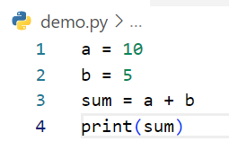
Write step following code below
Step | a | b | sum | output
1 | 10
2 | 10 | 5
3 | 10 | 5 | 15
4 | 10 | 5 | 15 | 15
Example

Slide 11
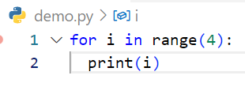
Write step following code below
Step | i | output
1 | 0 | 0
2 | 1 | 1
3 | 2 | 2
4 | 3 | 3

Slide 12
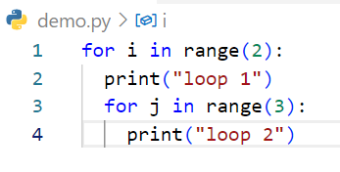
Write step following code below
Step | i | j | output
1 | 0 | 0 1 2 | loop 1, loop2, loop 2 loop 2
2 | 1 | 0 1 2 | loop 1, loop2 loop 2 loop 2

Slide 13
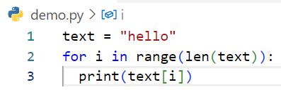
Write step following code below
Step | text | i | output
1 | text | 0 | h
2 | text | 1 | e
3 | text | 2 | l
4 | text | 3 | l
5 | text | 4 | 0

Slide 14
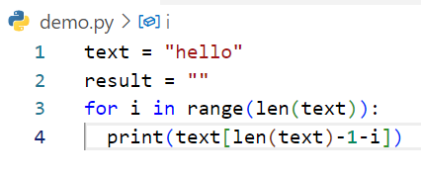
Write step following code below
Step | i | text | result | output
1 | 0 | hello |  | o
2 | 1 | hello |  | l
3 | 2 | hello |  | l
4 | 3 | hello |  | e
5 | 4 | hello |  | h

